Slide 1
EventsApp
Jeremy Aranguren, Nora Bonifas, Maria Gocal-Kappos, Linette Maliakal, and Janeen Soria
Notes:
http://csteach422.github.io/coursework/#assessment2

Slide 2
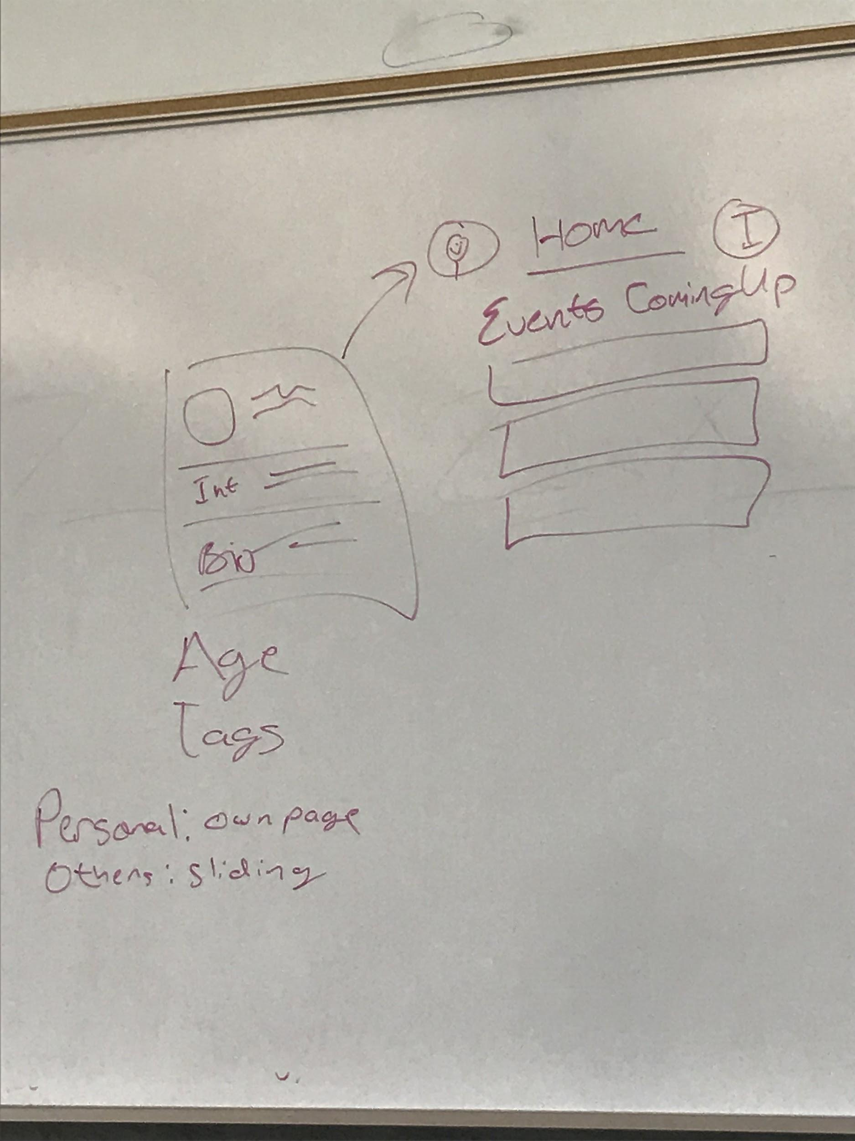
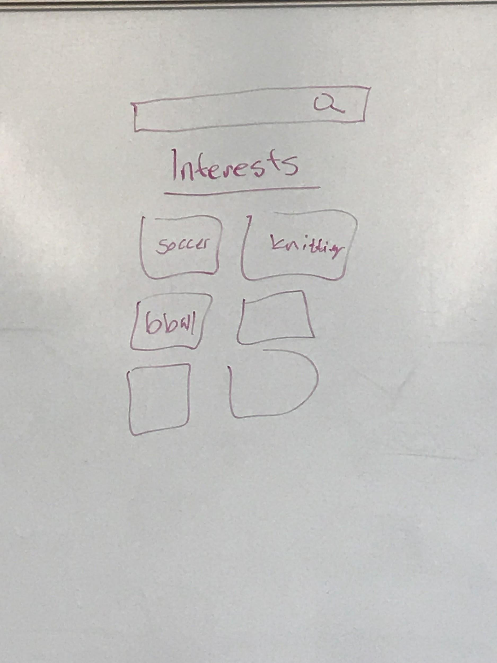
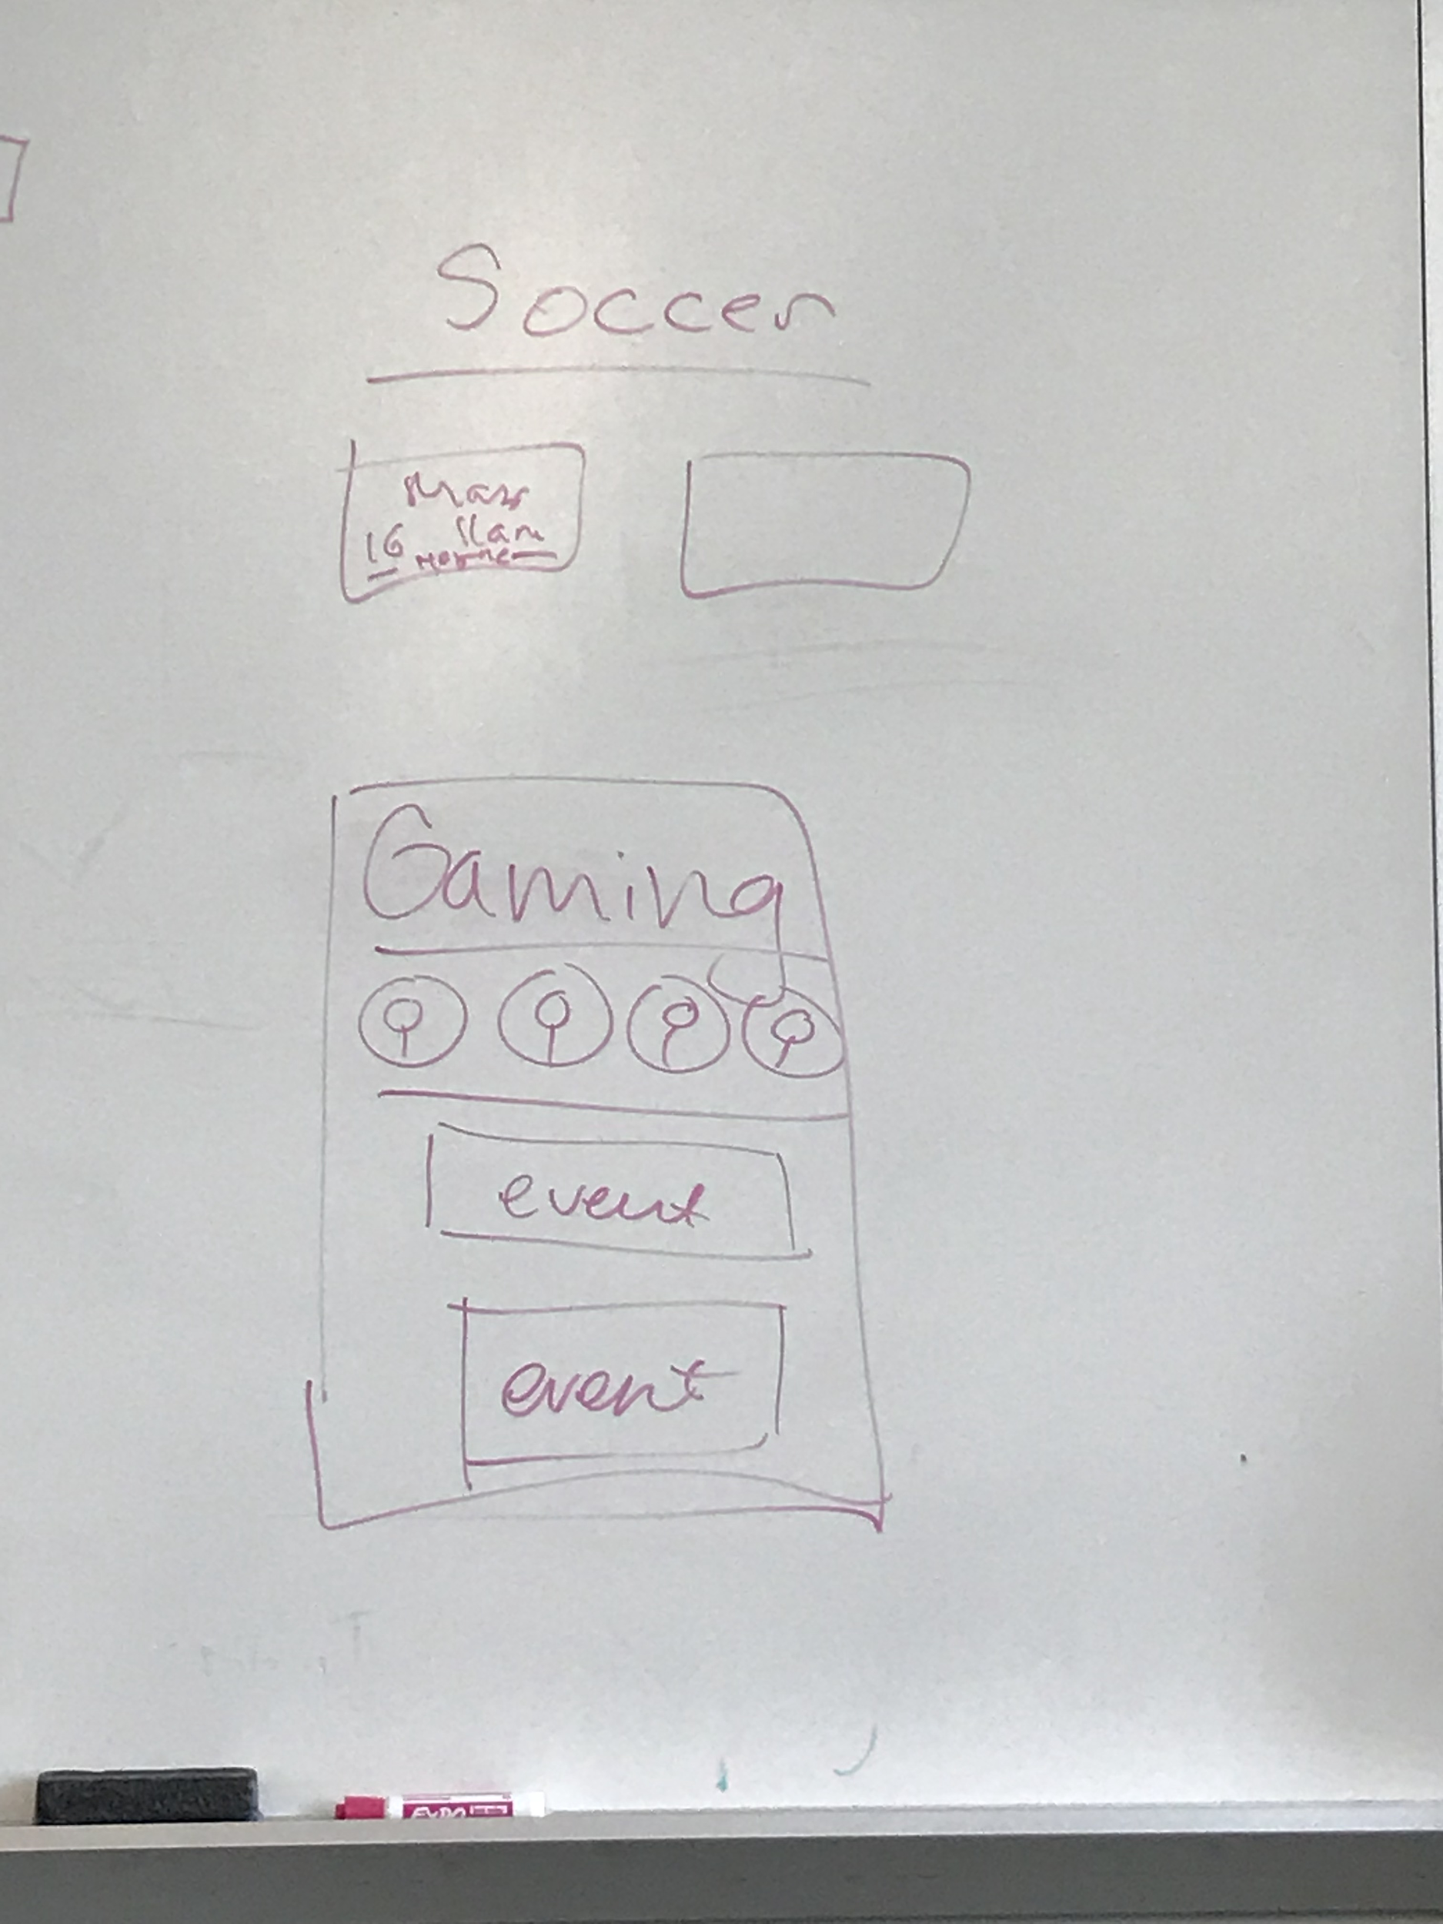

Slide 3
Our Process
Influences:
Facebook
People want to connect with others
Has an events feature
Dating apps
People want to find other people who share similarities with them
Helps find other users within a certain distance
Purpose for our app
Allow people to easily find a fun event in their area
Help users make new friends with similar interests
Help users find places where they can participate in something they are interested in
Notes:
Nora

Slide 4
Events/Interests App
Relies on geolocation to find nearby events and places for an interest
Users have own account
Profile page, events page, and an interests page
Audience:
Anyone who is interested in socializing with others from a certain activity and/or interest
People who may want to have more interests or learn something new
Notes:
Maya

Slide 5
Events Page
The home page
Users can quickly see what events are happening soon
Profile icon (top left)
Tap or slide right to go to your own profile page
For quick access
Interests icon (top right)
Tap or slide left to go to the interests page
If users can’t see events they are interested in, then they can go find events through specific interests
Most recent events appear at top, then later dates are below
In chronological order
Long rectangles that users can tap on
Notes:
Linette

Slide 6
Profile Page
Your own profile
Can access through icon with the P
A small picture, their age, tags of their interests
Rating of the person
To show if the user is reliable when going to events
To show if user is respectful
See the upcoming events you will be attending
Other users’ profile
Can access when viewing who is going to an event
Tap on profile and a small bubble will appear over screen to allow viewers an idea on who they are
Notes:
PhluffyPanda - We talked about users having their own profile and being able to see other people's profile. And we said that if we see other people's profiles, it would be a thing that slides into the screen, so does that mean that that feature appears when users look at events and tap on the people who are going there?
Maybe instead of the sliding feature we can do this? Generally i dont think users should have profiles that have a lot on it or else itll feel like tinder where people look at each others' profiles a lot

Slide 7
Interests Page
Search bar
Helps users find interests easily
Profile icon (right) to allow users easy access to the other pages
Events icon (left) to allow users easy access to the other pages
Interests are boxes that users can tap on
Each interest has their own page that shows its events
Shows users who are interested in it if there are no events
Interests are shown in alphabetical order
Notes:
Janeen
- Show most recently viewed at the top

Slide 8
https://pr.to/5V4HF6/

